Slide 1
Representation of Women in the United Nations System
IANWGE 23 February 2012
Aparna Mehrotra and Marilyn Dawson

Slide 2
Overview
Numbers and trends
Beyond the numbers-taking stock of progress
Key challenges
Looking ahead

Slide 3
United Nations System Statistics- Representation of Women
Professional and higher categories in the UN system 40 per cent as of 31 December 2010
High 57.3% at the P-2 level
Low 25.7% at the D-2 level
Glass ceiling at the P-4 level 38.4%

Slide 4
Percentage of Women in the Professional and Higher category with Appointments of one or more years in the UN System (December 2010)

Slide 5
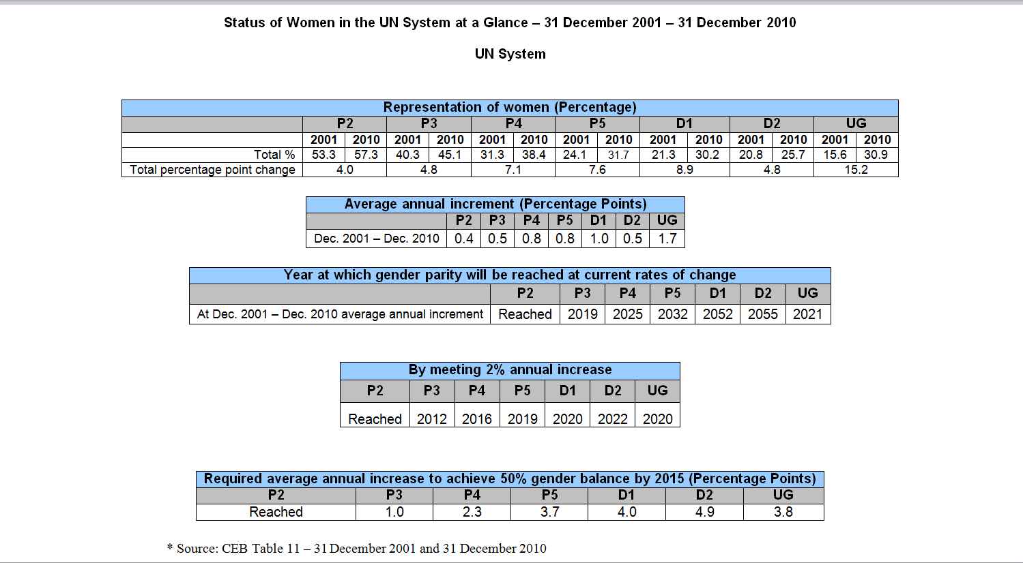
UN System Trends
* Source: CEB Table 11 – 31 December 2001 and 31 December 2010

Slide 6
UN System Trends and Conclusions
Successes
Parity has been reached only at the P2 level (57.3%)
Highest annual increment is at the UG level (1.7%)
From 2007 through 2010, the UN Secretariat experienced an unprecedented increase in women at the most senior levels — from 17 percent to 29 percent (39 men and 16 women) at the Under-Secretary-General level, and from 20 percent to 25 percent (48 men and 16 women)at the Assistant Secretary General level.
Challenges
Only 25.7% of staff in the D-2 level are women
Years in which parity will be reached ranges from 2020 at P3 to 2060 at D-2.
Lowest average annual increment is 0.4 at the P-2 level.

Slide 7
Leadership Messages
“As a standard-setting organization, the UN has a particular responsibility to achieve gender balance and to lead by example.”
Michelle Bachelet, 22 February 2011
“As a standard setting organization, the United Nations should lead by example”
Ban Ki-Moon, 23 December 2011
Accelerate progress at levels with least improvement:
P-4 to D-2
Important role of Departmental Focal Points for Women
Maintain accurate statistics to measure progress
Gender friendly work environment -Stigma free FWA

Slide 8
Upcoming Issues: some examples
Promulgate gender balance strategy and action plan(SWAP)
Incorporate gender balance in mobility policy
Effectuate ST/AI/1999/9 “Special Measures for the Achievement of Gender Equality”
Placement focal point for women
Strengthen implementation; monitor and track progress of FWA
Study situation of pregnant women in difficult duty stations

Slide 9
Beyond the Numbers
SWAP gender balance indicators (System-wide Action Plan on Gender Equality and the Empowerment of Women)
Gender Based Violence (GBV) and the Workplace: Report and Policy
Consultations with Focal Points
Gender and Ageing
Workplace Flexibility

Slide 10
CEB-SWAP System-wide Action Plan on gender equality and the empowerment of women
Extensive consultative process involving over 50 UN entities, Secretariat Departments and Offices, and inter-agency coordination bodies
Piloting of the CEB- SWAP by eight entities – UNDP, UNFPA, UNICEF, IAEA, IOM, ESCWA, OHCHR, UNAIDS
The CEB-SWAP is an integrated framework for both gender balance and gender mainstreaming

Slide 11
3 CEB-SWAP Indicators on gender balance
Area of CEB Policy D Human and Financial Resources Indicators
Element 10 in Gender Architecture
Focal points system
Equal representation of women
Element 11 in Organizational Culture
Supportive culture

Slide 12
Gender Balance related SWAP indicators: Gender Architecture Element 10 –representation of women
Approaches Expectations
Plan in place to achieve the equal representation of women for General Service staff and at P4 and above levels in the next five years.
Meets Expectations
The entity has reached the equal representation of women for General Service staff and also at P4 and above levels including the senior most levels of representation in Field Offices, Committees and Funds linked to the entity irrespective of budgetary source.
Exceeds Expectation
The entity has reached the equal representation of women for General Service staff and also at P4 and above levels including the senior most levels of representation in Field Offices, Committees and Funds linked to the entity irrespective of budgetary source

Slide 13
Gender Balance related SWAP indicators: Gender Architecture Element 10 – focal points
Approaches Expectations
Gender focal points or equivalent at HQ, regional and country levels are:
a. appointed from staff level P4 and above for both mainstreaming and representation of women
b. have written terms of reference
c. at least 20 per cent of their time is allocated to gender focal point functions
Meets Expectations
Gender focal points or equivalent at HQ, regional and country levels are:
a. appointed from staff level P5 and above for both mainstreaming and representation of women
b. have written terms of reference
c. at least 20 per cent of their time is allocated to gender focal point functions
Exceeds Expectations
Gender focal points or equivalent at HQ, regional and country levels are:
a. appointed from staff level P4 and above
b. have written terms of reference
c. at least 20 per cent of their time is allocated to gender focal point functions
d. specific funds are allocated to support gender focal point networking
and
The entity has reached the equal representation of women for General Service staff and also at P4 and above levels including the senior most levels of representation in Field Offices, Committees and Funds linked to the entity irrespective of budgetary source
and
Gender department/unit is fully resourced according to the entity mandate

Slide 14
Gender Balance related SWAP indicators: Organizational Culture Element
Approaches Expectations
Organizational culture partly supports promotion of gender equality and the empowerment of women
Meets Expectations
Organizational culture fully supports promotion of gender equality and the empowerment of women
Exceeds Expectations
Organizational culture fully supports promotion of gender equality and the empowerment of women and
senior managers demonstrate

Slide 15
Beyond the Numbers: GBV
Expert Group Meeting on Gender Based Violence and the Workplace
December 2011, New York – Report and Policy Template
The impact of gender-based violence on employee performance and productivity:
• 37% of women who experienced domestic violence reported that it had a negative impact on their job performance, including lateness, absenteeism, decreased job retention and career advancement.
• Women who had recently experienced domestic violence lost 26% more work time to absenteeism and lateness than non-victims.
• A quarter of the 1 million women who are stalked each year report absenteeism as a consequence, missing an average of 11 days
• 41% of violent perpetrators are found to have job performance issues and 48% reported having difficulty concentrating as a result of their abusive behaviors.
Source: The Impact of Domestic Violence on the Workplace, Pennsylvania Coalition Against Domestic Violence. Available at: www.pcadv.org/Resources/Impact.pdf; Domestic Violence in the Workplace, National Coalition Against Domestic Violence. Available at: www.ncadv.org

Slide 16
GBV and the Workplace
The cost to the employer:
• A US study estimates that in America alone, the annual cost of domestic violence owing to lost productivity is $727.8 million, with almost 8 million paid work days lost each year.
• In America, the cost of intimate partner violence associated with direct medical and mental health services is $4.1 billion, and a substantial proportion of this cost falls on the employers.
Source: The Facts on the Workplace and Domestic Violence, Futures Without Violence. Available at: http://www.futureswithoutviolence.org/userfiles/file/Children_and_Families/Workplace.pdf

Slide 17
Elements of GBV and Workplace Policy
Disallow retaliation against victims.
Recommendations for flexibility with the provision of leave and benefits.
Encouragement for employers to actively participate in safety planning for victims.
Respect the confidentiality of the situation.
Defer to the survivors' assessments of safety wherever reasonably possible, and actively promote prevention and awareness training.

Slide 18
Consultations with Gender Balance Focal Points
On-going consultation to capture wisdom and experience of gender balance focal points
20 participants each representing an entity or Secretariat Department
(10 Entities 9 Secretariat)
Key Challenges Mentioned
Lack of resources and isolation
Lack of qualified female candidates, but who is qualified?
Geography given priority over gender
Organizational culture (old boys network)

Slide 19
Some Focal Point Suggestions
Strengthen Advocacy and Coordination
Institute revitalized special measures
Better integrate gender mainstreaming and gender balance.
All issues that UN Women promotes on the outside should also be promoted in the UN system
Use UN Women leverage for accountability framework (SWAP)
Joint Events
UN Women and ILO to host meeting of Heads of HR, Gender Bureaus, Chefe de Cabinet on recruitment and career paths of women

Slide 20
Some Focal Point Suggestions
Improved Communication
Reproduce material from 2012 SG’s report in more “punchy” format for member states and entity advocacy and information
Provide guidance to managers on the effects of GBV in the workplace (EGM)

Slide 21
Suggestions for Role of UN Women
Strengthen inter-agency gender balance focal point network and integrate into wider gender networks.
Knowledge Network – Better share experiences of entities and departments
Capacity Building – Mandatory “representation of women awareness” module in existing training
Recruitment – Encourage member states to propose women candidates

Slide 22
Gender and Ageing
The Status of the World’s Older Women and Progress since the Madrid International Plan of Action on Ageing (1)
Existing human rights instruments do not go far enough in protecting the rights of older women.
The adoption of General Recommendation 27 by the CEDAW Committee is significant in this respect because it points to the lack of progress in advancing older women's rights over the last decade.

Slide 23
The Status of the World’s Older Women and Progress since the Madrid International Plan of Action on Ageing (2)
Older women are falling into the gap between gender policies and ageing policies. For example, in the case of violence and abuse, which has seen huge progress over the last 10 years, the majority of research and service provisions focus on women of reproductive age.
In the latest CEDAW country reports, violence and abuse was the issue least reported on in relation to older women.
In the same vein, ageing policies tend not to account for the specific needs of older women and are based on data which is often not disaggregated by sex (e.g. in cases of humanitarian crisis).

Slide 24
The Status of the World’s Older Women and Progress since the Madrid International Plan of Action on Ageing (3)
Part-time work and time off options are essential in enabling women to provide care, but women must not be penalized for their domestic contributions in old age.
The contributions that many women make throughout their lifetime in caring and domestic roles lessen the demands on state and society, and benefit family and society alike.
Nevertheless the consequence is that older women are less entitled to contributory pension benefits and often go without any remuneration at all, diminishing their financial security when it is most needed.

Slide 25
The Status of the World’s Older Women and Progress since the Madrid International Plan of Action on Ageing
Analysis Points to the need for:
inter alia
Improve data on the interactions between gender and ageing
Reinforce and Protect the Human Rights of Older Women
Ensure that gender is mainstreamed into ageing policies, and ageing is mainstreamed into gender policies.
Ensure compensation for variable participation in the labour force
Take urgent, coordinated action to improve research and policy responses to elder abuse, with specific regard to the needs of older women.
Prioritize the needs of rural older women in public policy

Slide 26
Beyond Numbers: Work-Life
EGM on Measures to Expand Flexibility and Improve the Work-Life Integration of Employees in the United Nations System
Inadequate flexibility has been highlighted in several reports of the Secretary-General as one of the causes for the slow progress towards the goal of 50/50 gender parity
Proposed Work Life Strategy and Action Plan for the United Nations, also applicable to a range of modern and technology equipped professional organizations
Substantial focus is placed on building the confidence of managers in the concept, changing the work culture, expanding the usage and improving the management of FWAs, and embedding career path flexibility. The plan is presented with the understanding that individual entities, departments and offices can adapt it to their needs

Slide 27
Public Sector Work-Life Initiatives Some Examples
Singapore – Ministry of Manpower
Flexi-Works! – grant of up to S$100,000 for companies to hire new workers on part-time or flexible arrangements
Work-Life Works! (WoW!) – up to S$20,000 of funding available to each selected company to implement work-life strategies
Work-life toolkit
Finland – Statistics Finland
Comprehensive work-life policies
Work-life surveys since 1977
United States – White House Flexibility Forum – Department of Labor
New work-life office in the White House and one in every federal office in all U.S. states
Women’s Bureau flexibility dialogue Summer 2011 in New York, NY
Work-Flex Event Starter Kit

Slide 28
Joint Inspection Unit-Draft Report on Management of Sick Leave in the UN System
Psychological and psychiatric disorders remain the main cause of long-term absences for both men and women.*
The causes of psychiatric reasons of absence showed that 30% of the cases were linked to work.*
*Source: http://myintracomm.ec.europa.eu/hr_admin/en/medical/Pages/index.aspx

Slide 29
Future Priorities UN Women Work Plan Highlights 2012
IWD side event on women in non-traditional areas March 7, 2012
EGM on special measures for gender equality
Communications plan for gender balance and gender mainstreaming to increase awareness and knowledge of the issues.
SG’s report on the improvement in the status of women in the UN system 2012

Slide 30
Secretary-General’s Report on the Improvement of the Status of Women in the United Nations System 2012
Questionnaire
Data
Qualitative survey
Examples of good practice

Slide 31
What do you think?
What can UN Women do more of, or do differently, to help you to help your organization improve the representation of women?
Priorities

Slide 32
THANK YOU

